Slide 1
Boosting Australia’s Diesel Storage Program
Webinar Event
Chair Mr. Shane Gaddes, Head of Division, Liquid Fuel Taskforce
Wednesday 10 February 2021
Supporting economic growth and job creation for all Australians | industry.gov.au

Slide 2
Australia’s Fuel Security Package
The Government is implementing a ten year comprehensive fuel security package.
  The plan will secure Australia’s long-term fuel security, keep prices low for consumers and create jobs.
Delivered through a combined market and regulatory framework:
  Investing $200 million in a competitive grants program to build an additional 780ML of onshore diesel storage
  Creating a minimum stockholding obligation for key transport fuels; and
  Backing the refining sector through production payments.

Slide 3
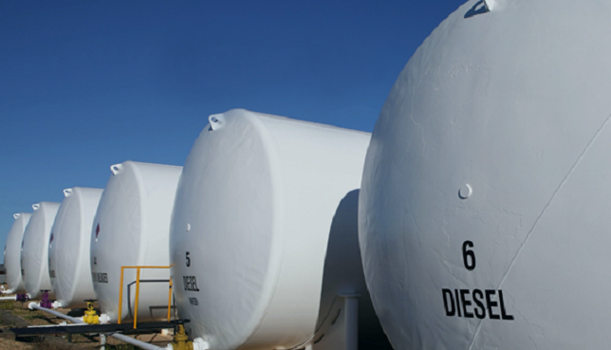
Program Overview
Boosting Australia’s Diesel Storage Program

Slide 4
Boosting Australia’s Diesel Storage Program
$200m in matched funding to support industry to build an additional 780 megalitres of domestic diesel storage capacity
  To support Australia’s fuel security and create jobs, contributing to the Government’s JobMaker Plan and COVID-19 economic recovery agenda.
  Projects are constructed owned and operated by industry and industry owns the diesel not the Government.
  Filling of the storage is not an eligible expense.
Projects may receive between $6 million to $33.3 million for construction within 36 months - by 30 June 2024

Slide 5
Program Timeline
Applications close 5:00pm AEST, Monday 22 February 2021
  The timing reflects the ambition of the Government for projects to commence on 1 July 2021
Applications Close | 22 February 2021
Eligibility Checks | February – March 2021
Eligible Applications Assessed by Committee | March 2021
Minister Considers Committee Recommendations | March – April 2021
Negotiation of Grant Agreements and Announcements | April – June 2021
Start of funding for the program and earliest start date for projects and payments | 1 July 2021
Construction of projects and grants payments, | 1 July 2021 to 30 June 2024
End of Grant Payments | 30 June 2024

Slide 6
Applicant Eligibility
ABN Holder, not tax exempt and registered for GST.
Be a new project, which has not already commenced construction and meet additionality requirements.
have at least $12 million in eligible expenditure.
be designed to create no less than 20 megalitres in additional storage of diesel fuel at any individual site (projects may involve one or more sites across Australia).

Slide 7
Assessment Criteria
Evidence provided will be used to assess the competiveness of your application
Three criteria:
  Alignment with the program objectives.
  Your capacity, capability and resources to deliver the project.
  The impact of the grant funding on your project.
  Further detail should be added in your project plan

Slide 8
Your Project Plan should:
Outline your strategy to manage the project, identifying timeframes, budget, and risk
Address work, health and safety, financial, land access, technical and environmental risk
Detail how you project will comply with laws and regulation at the federal, state/territory and local level
Demonstrate how you will comply with relevant Australian Standards for storage and handling of combustible liquids

Slide 9
Application Process
Eligible Expenditure Vs
Incurred by you within the project period
Be a direct cost of the project
Be incurred by you to undertake required project audit activities
Meet the eligible expenditure guidelines
Plant and equipment
Labour including on costs and administrative overheads
See Appendix A
Non Eligible expenditure
Costs of fuel stock and related transport
Feasibility studies
Ongoing operational costs
Research activities not directly supporting eligible activities
Activities, equipment or supplies that are already being supported through other sources
Any in-kind contributions
Financing costs including interest
See Appendix B

Slide 10
Overview of the Application Assessment Phase
We will review your application for completeness and eligibility.
Eligible applications will be referred to the Assessment Committee.
The Assessment Committee will make funding recommendations to the Minister.
We will notify you in writing of the result of your application.
Successful applicants must enter into a grant agreement with the Commonwealth.

Slide 11
Reporting Requirements
Reports must be submitted in line with the grant agreement
Progress reports against agreed project milestones, project expenditure including expenditure of grant funds
End of project report
Grant payments will only be made if a satisfactory progress report has been received
Site visits may be undertaken during the project period

Slide 12
Tips for presenting a strong application against the Criteria
Explain the project:
  Simple, clear description of project and outcomes
  Concrete statements of activities and milestones
  Sound basis and explanation of the project budget
  Address the assessment criteria in full

Slide 13
Open Q&A Session
Open a web browser on your device
Navigate to slido.com
Enter the event code: #T800
Lets talk ...

Slide 14
Name: Business Grants Hub Contact Centre
Phone: 13 28 46
industry.gov.au

Slide 15
Thank you

